Slide 1


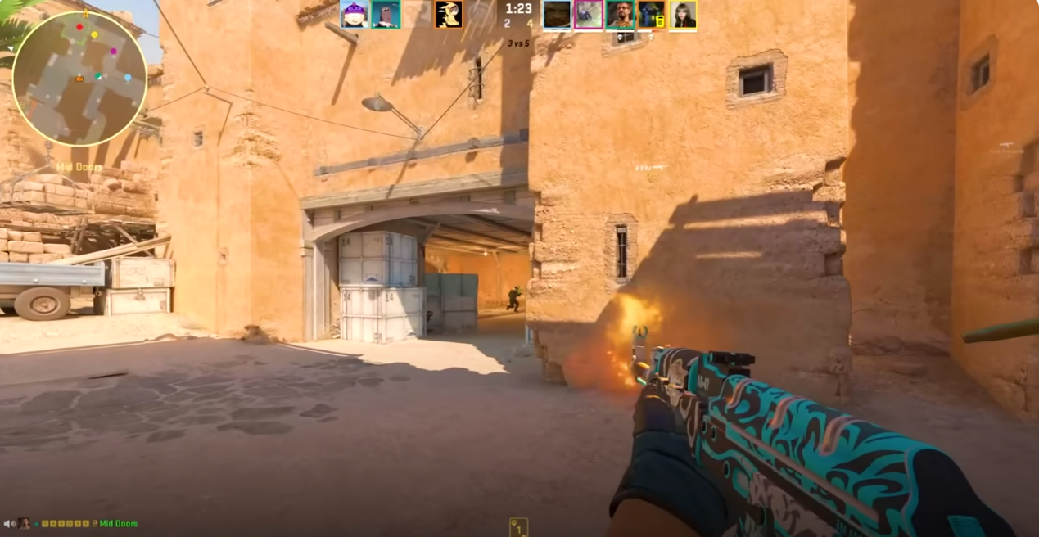
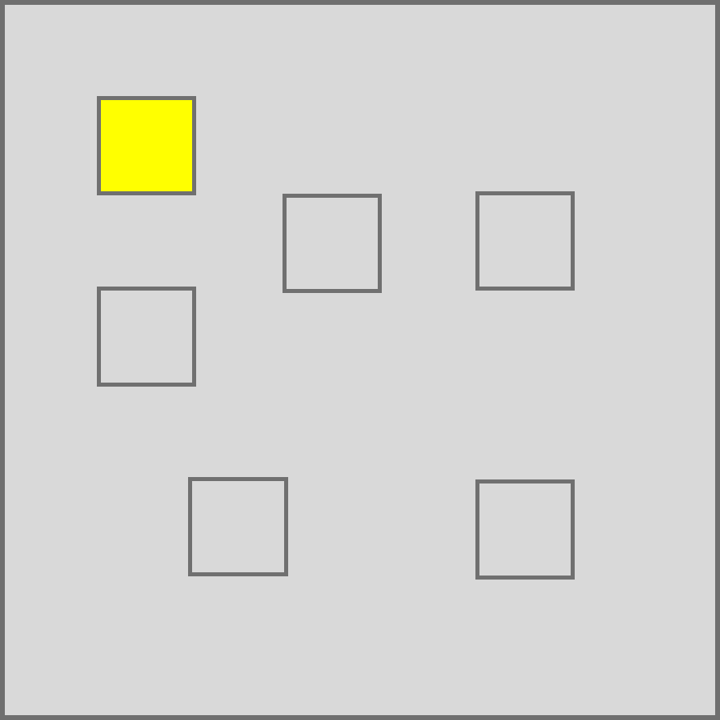
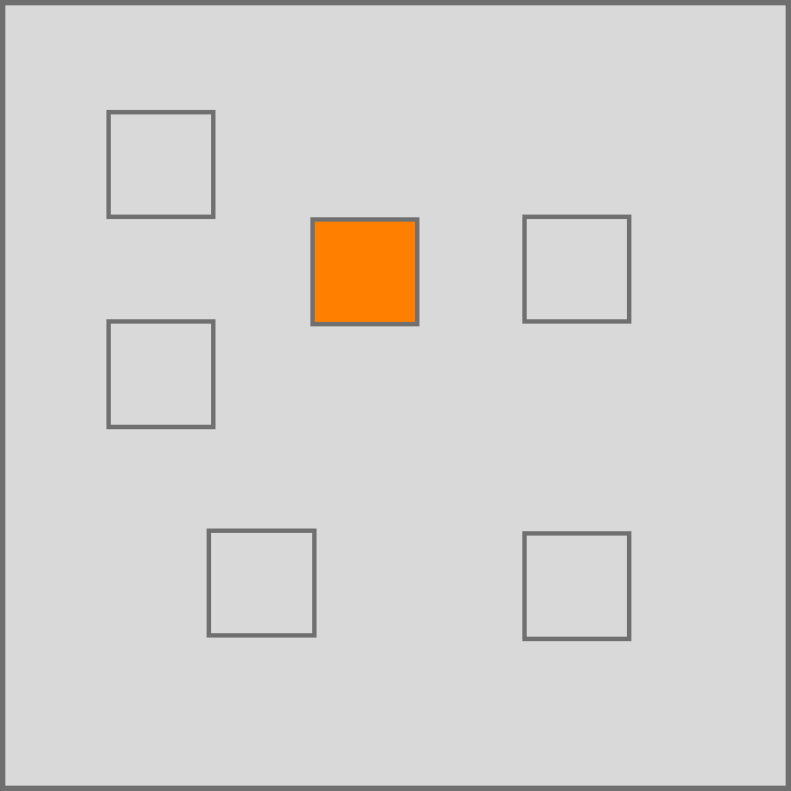
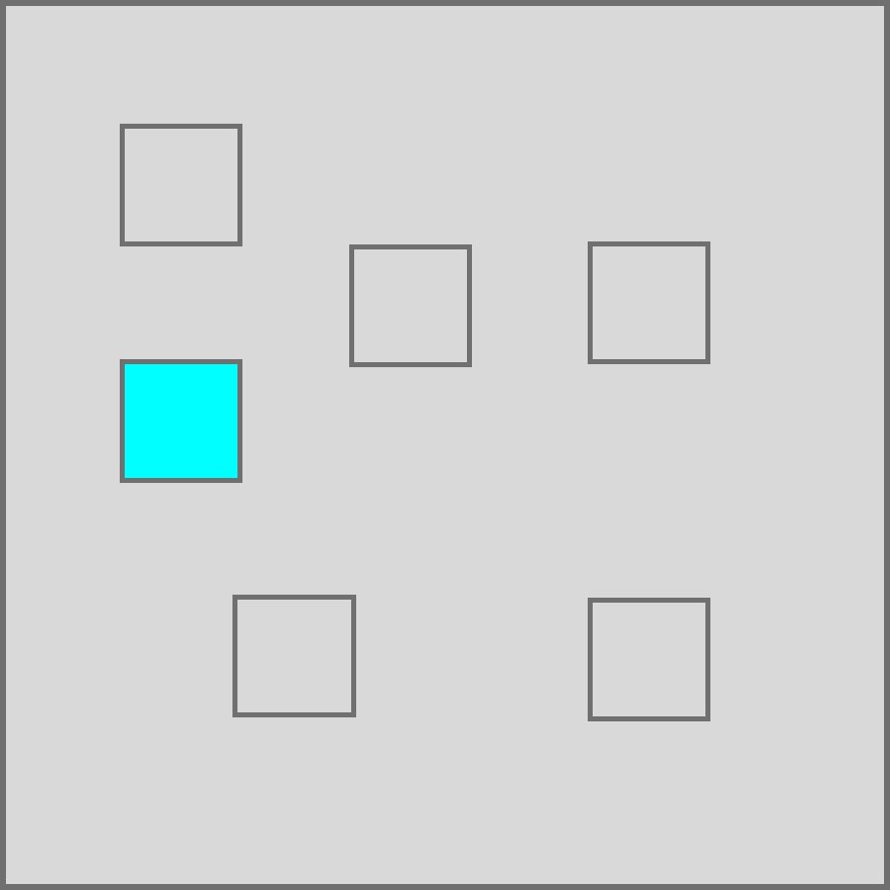
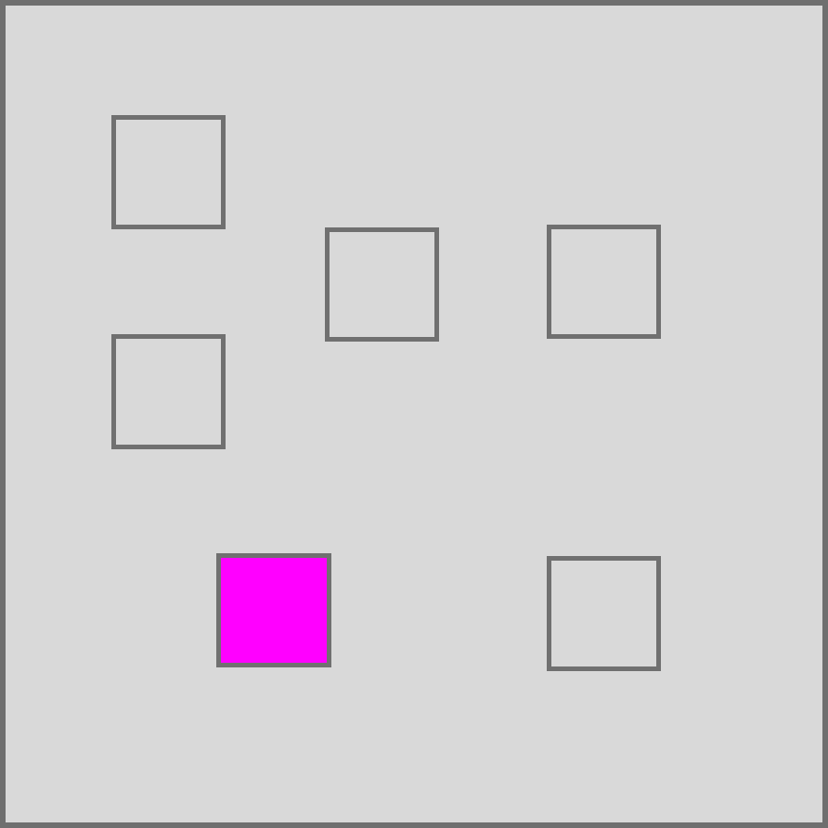
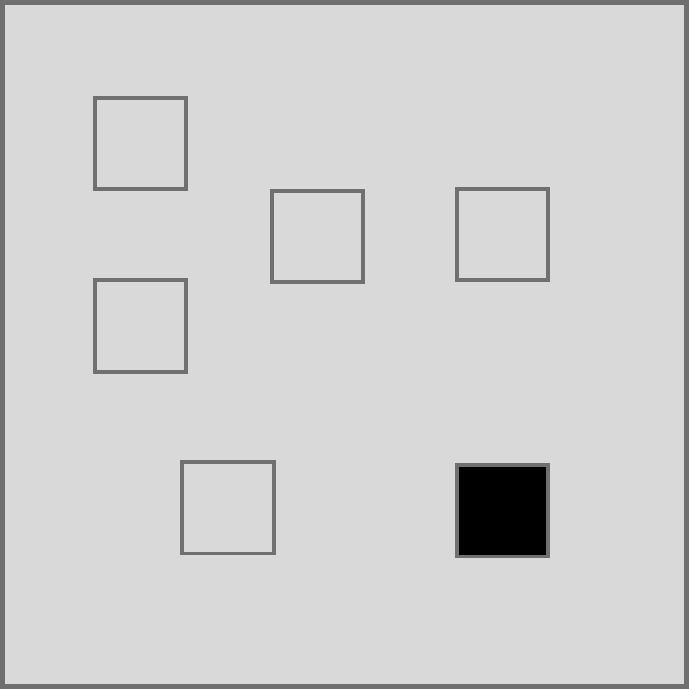
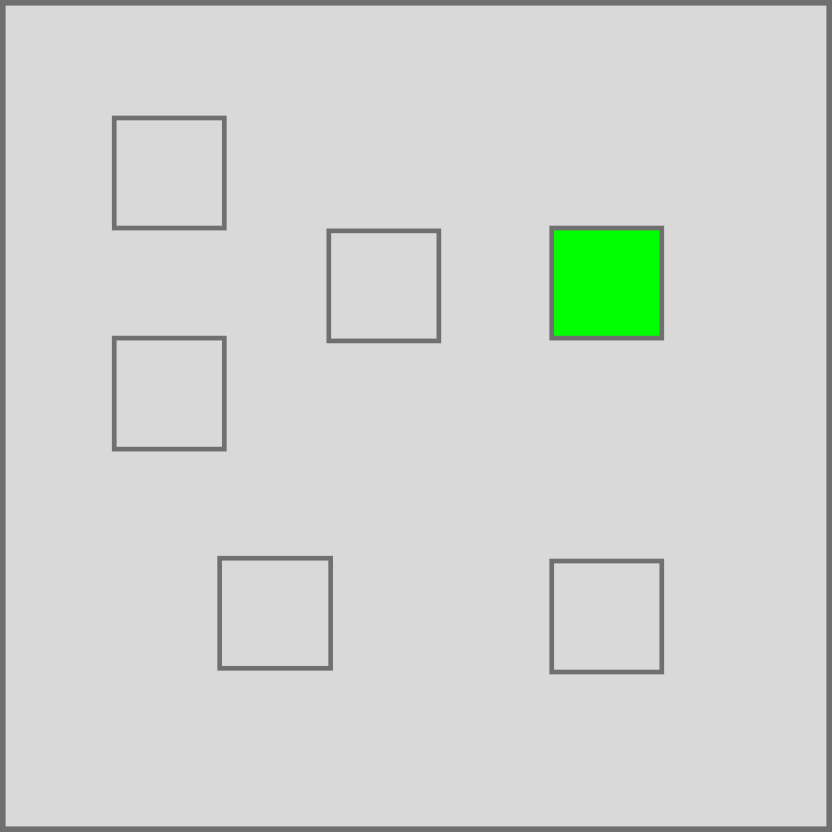
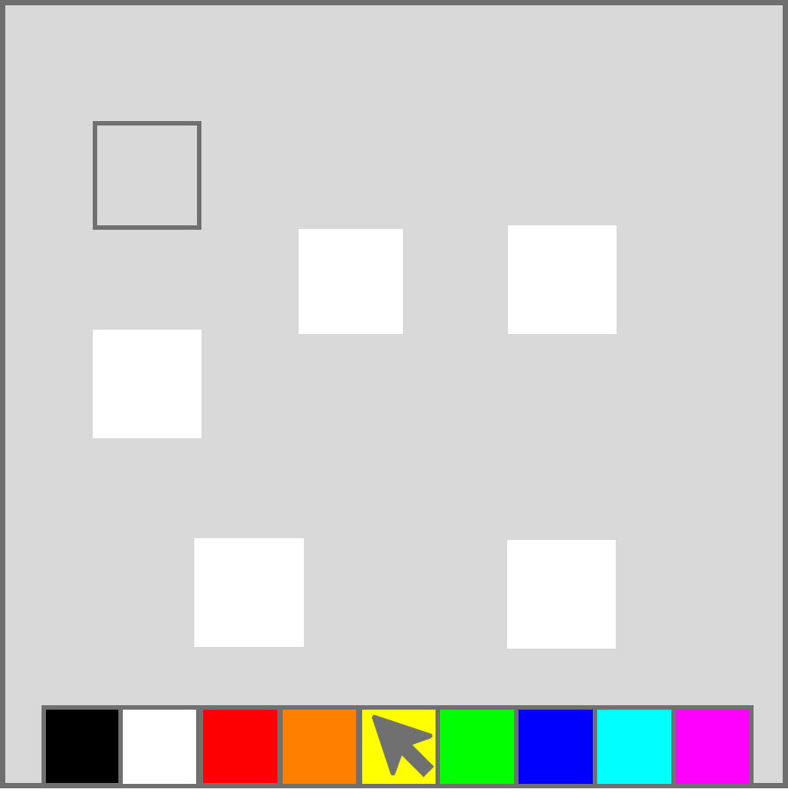
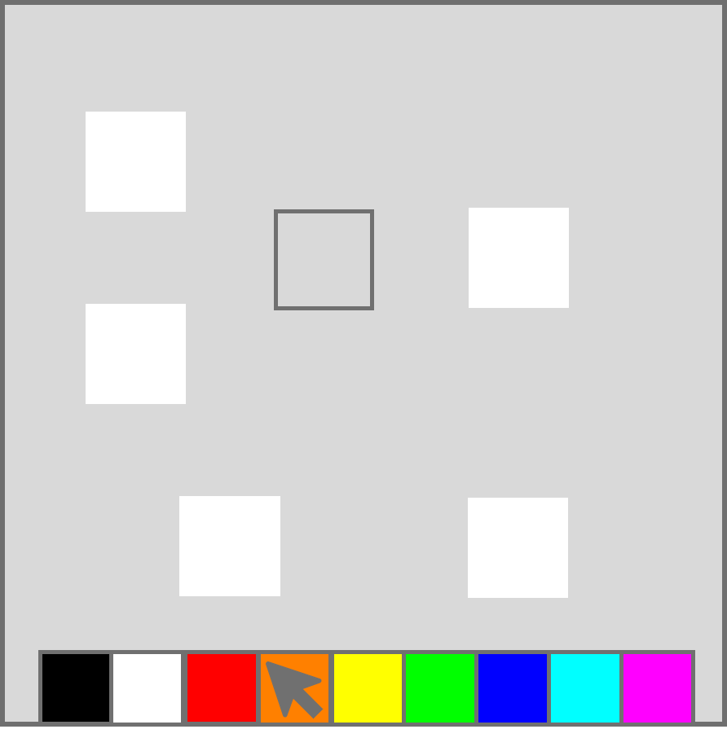
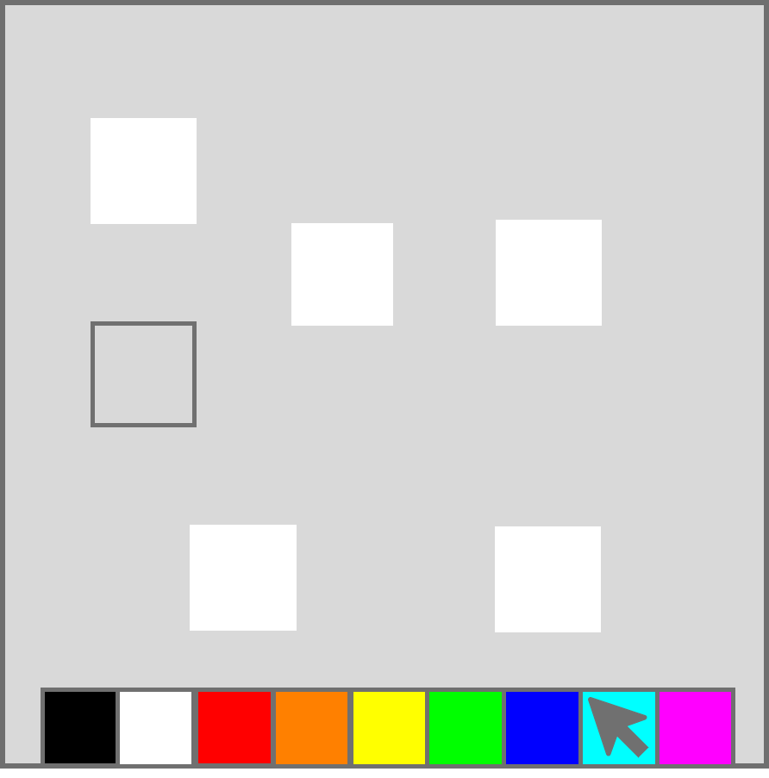
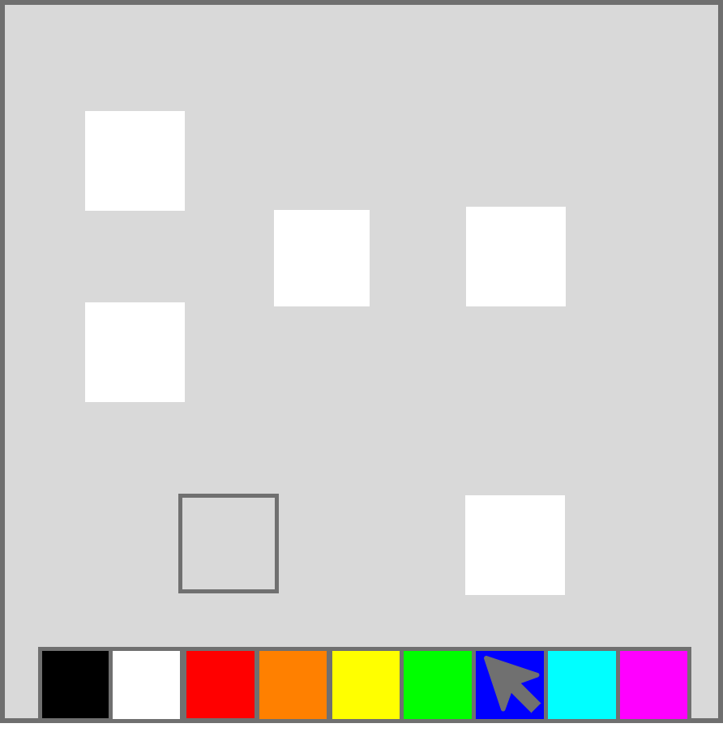
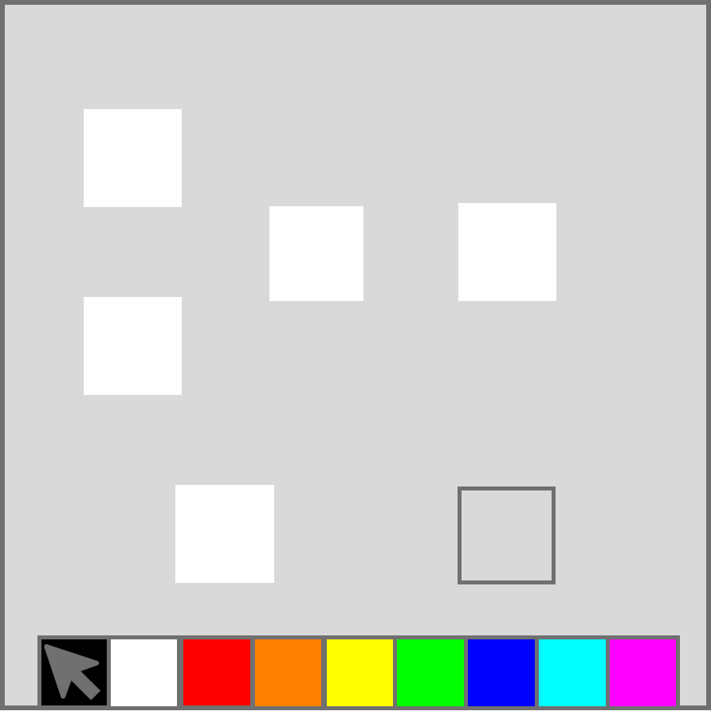
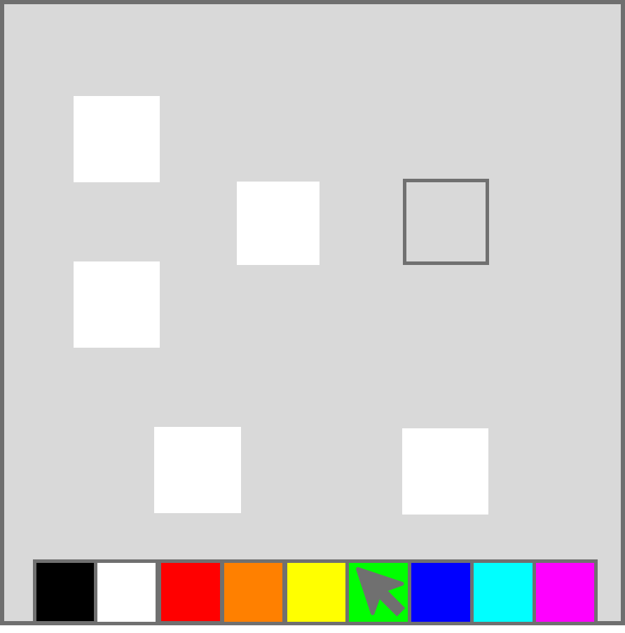
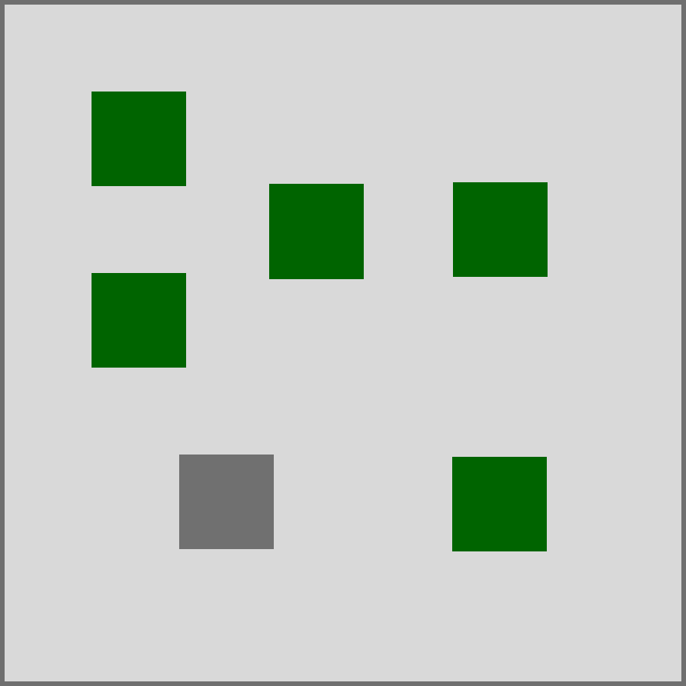
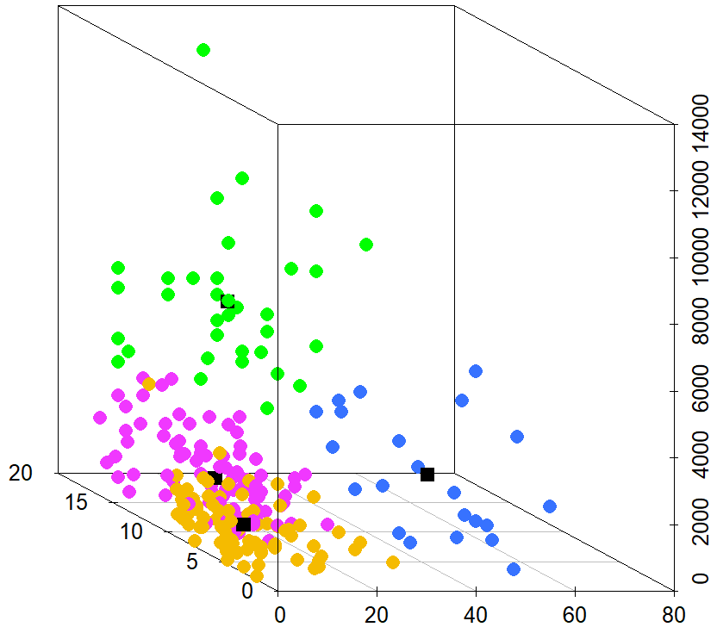
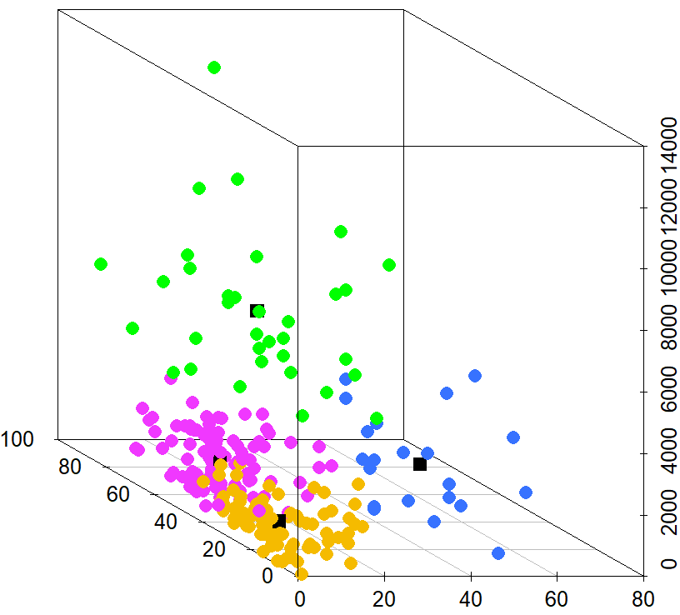
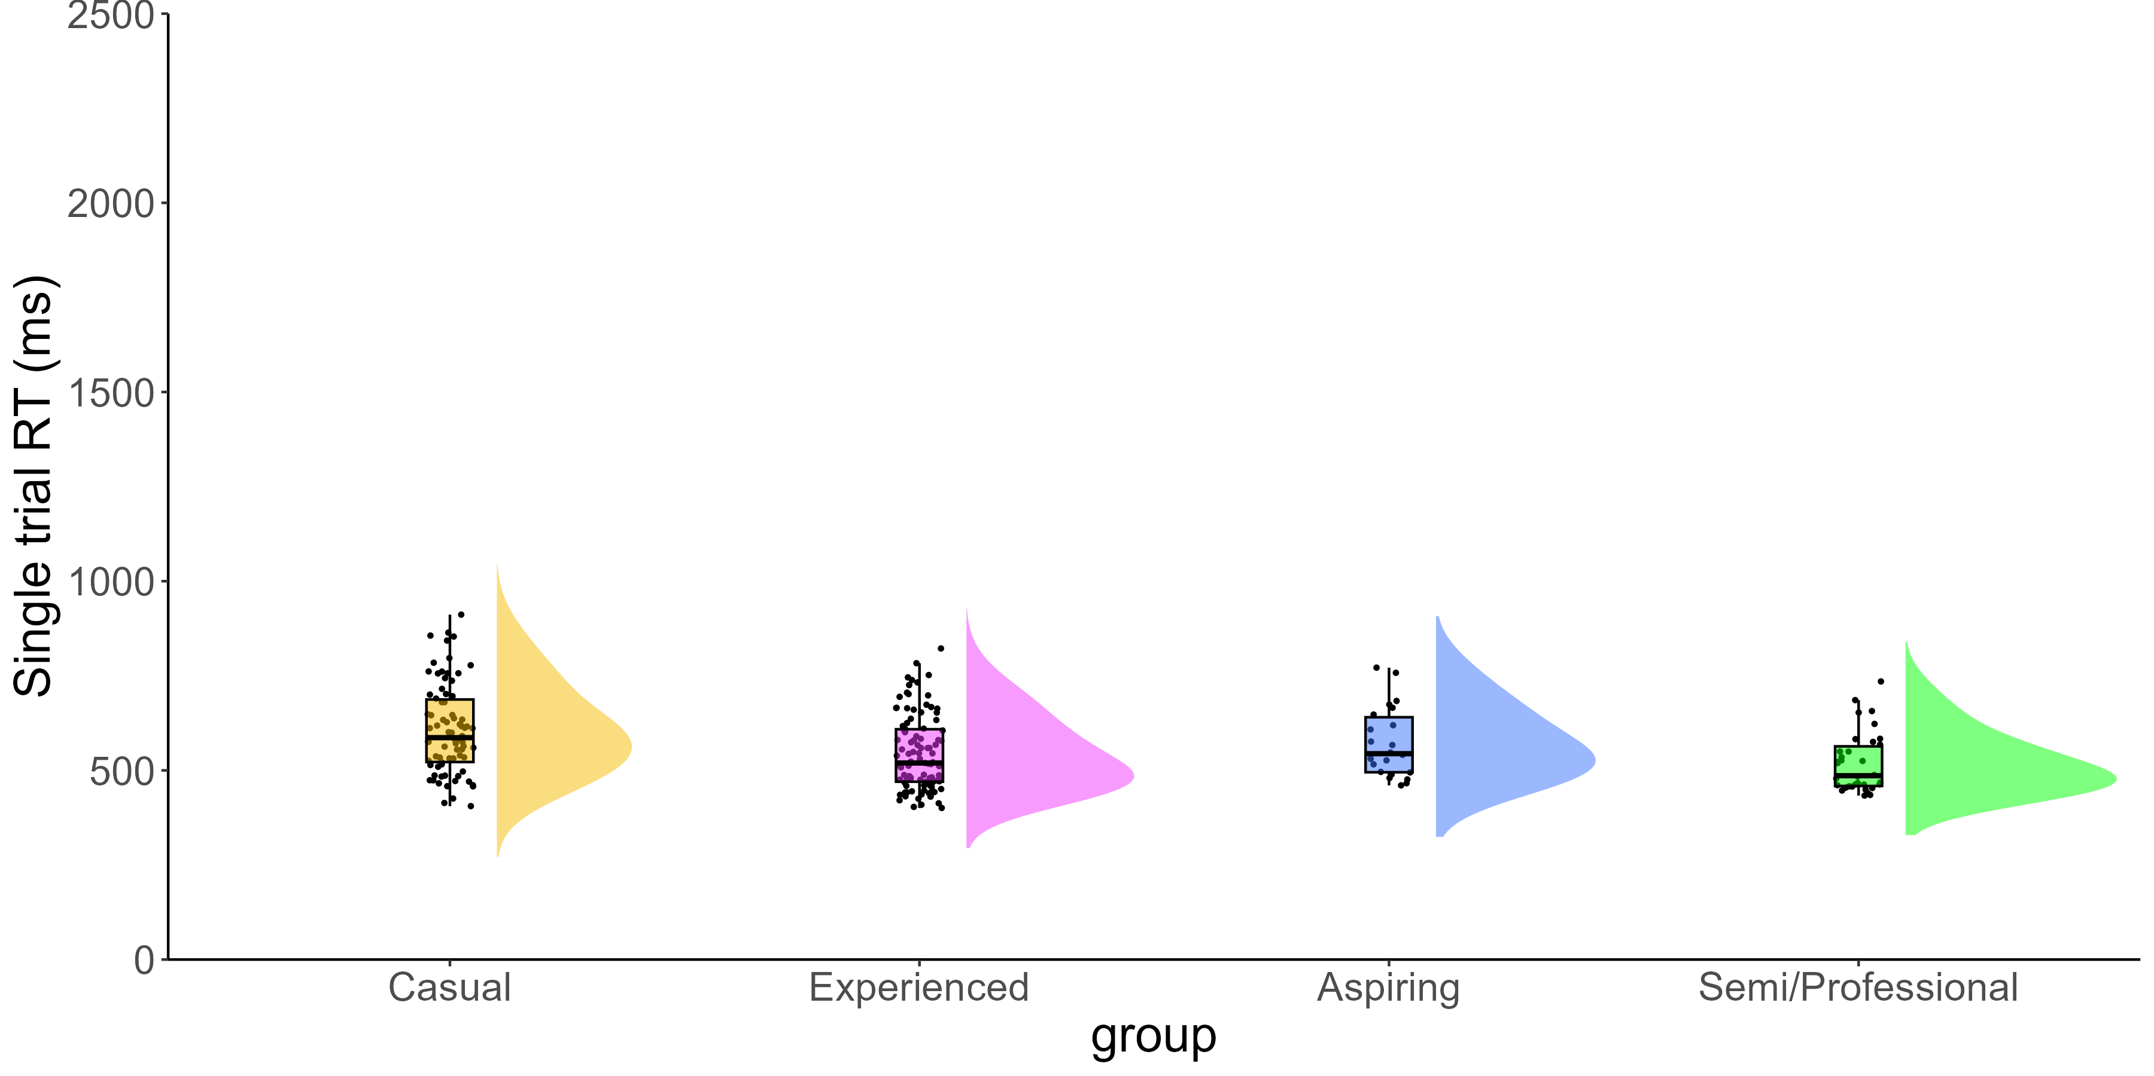
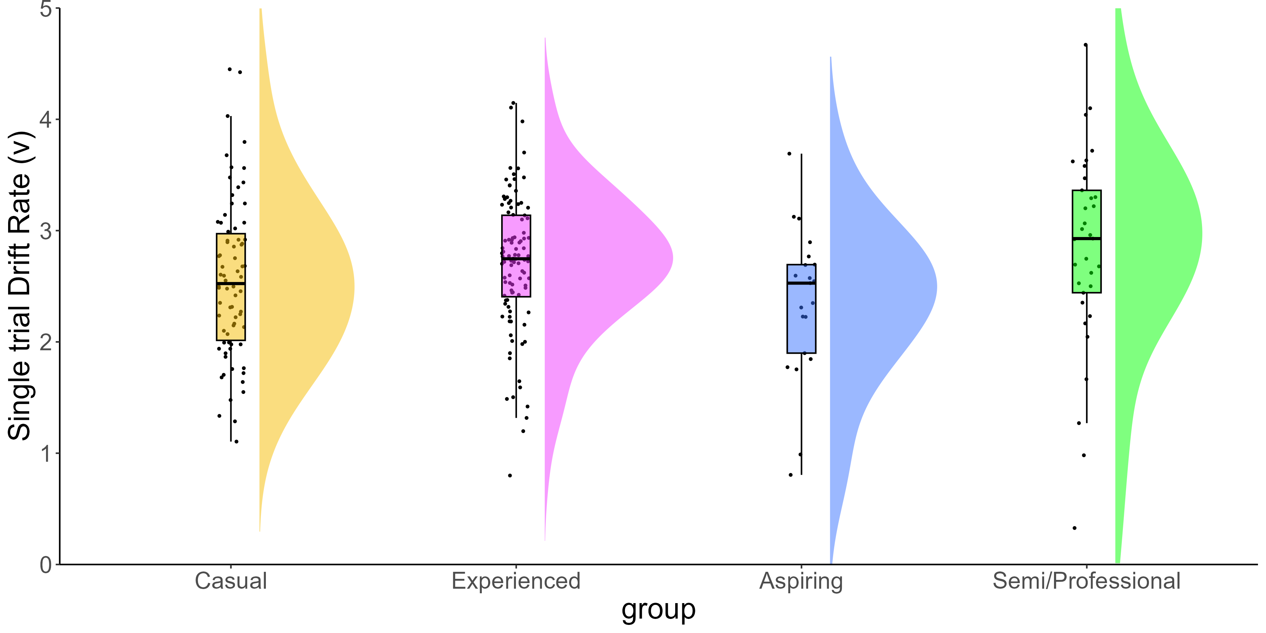
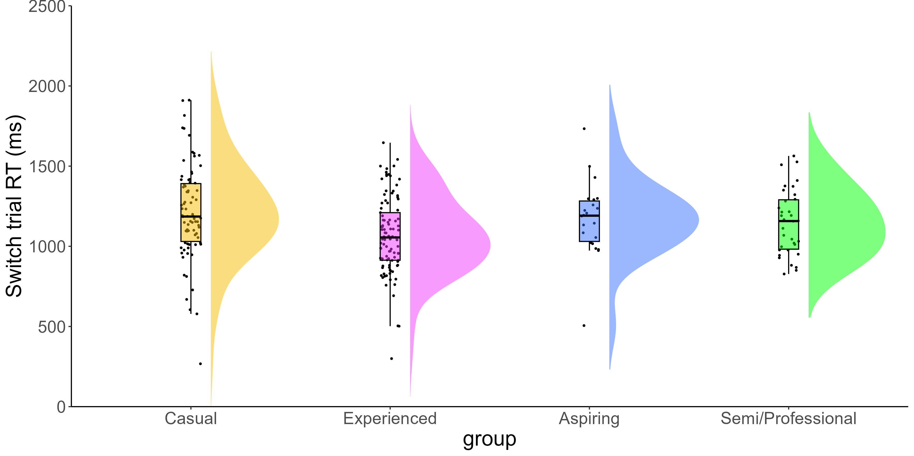
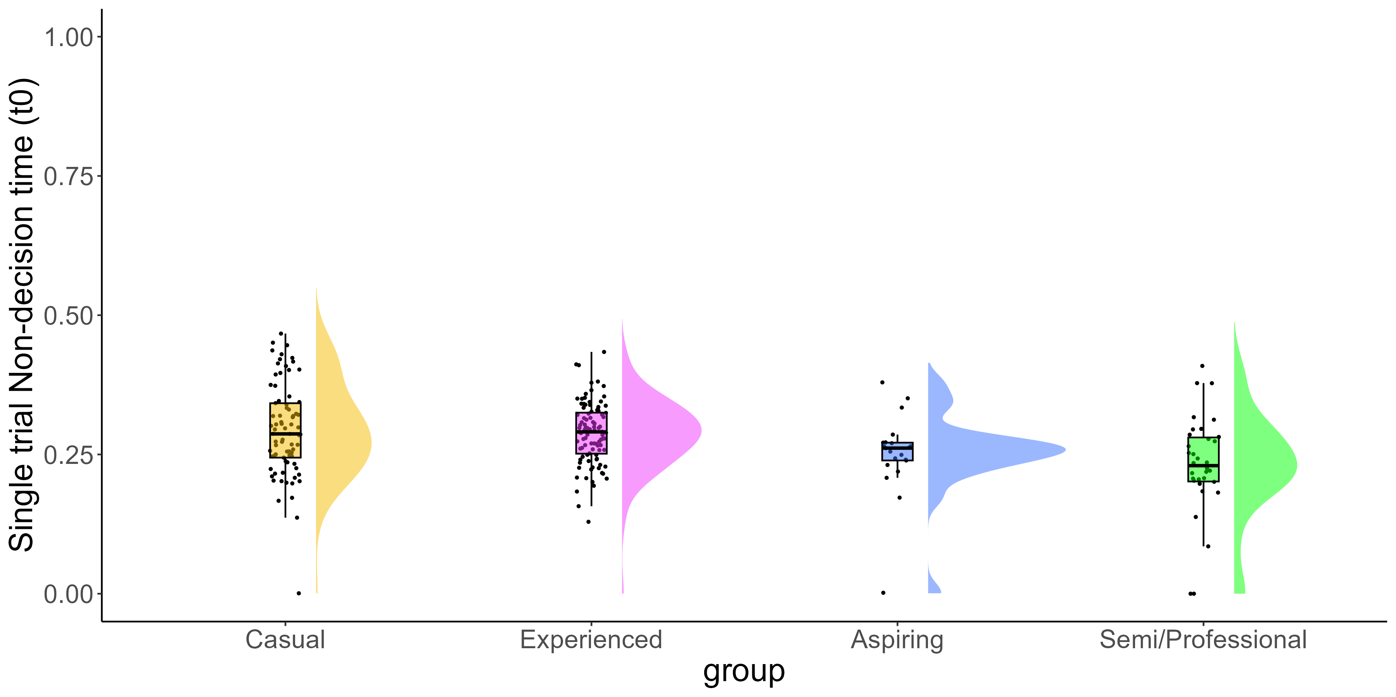
METHODOLOGICAL CHALLENGES OF VIDEO GAME RESEARCH
PROCESSING SPEED IN FIRST-PERSON SHOOTER AND NON-VIDEO GAME PLAYERS: A DRIFT-DIFFUSION MODEL APPROACH
Eleanor R. A. Hyde, Alice Reinhartz, Shuangke Jiang, Sylvie Belleville, Tilo Strobach & Claudia C. von Bastian
Background
Study 2
First Person Shooter (FPS) games are fast-paced, dynamic gun-based combat video games, which require fast decision-making.
00
Attempt 1
Cross-sectional study of Hebbian learning and processing speed in CS players.
Visuospatial Hebbian Learning task (Musfeld et al., 2022), Choice RT task measuring RTs and accuracy scores and CS expertise questionnaire.
N = XX, after filtering for erroneous questionnaire entries, N = 29.
Lesson: be a bit more open in the advertisement of your study and make the task shorter.
Attempt 2
Cross-sectional study of processing speed in non-video game (NVG) and CS players.
Taks and CS expertise questionnaire whilst at LAN event.
N = XX, after filtering for erroneous questionnaire entries, N = XX.
Lesson: in-person gaming events are not ideal for data collection, make the task and questionnaire shorter. Just advertise research there.
Attempt 3
Cross-sectional study of processing speed in non-video game (NVG) and CS players.
Large scale and shortened project
Research has shown FPS play to be associated with a range of cognitive enhancements (Bediou et al., 2023; 2018) however, these findings have been challenged (Sala et al., 2018).
Mixed findings may be due to methodological limitations such as broad definitions of FPS games, small samples of novice players and limited measures of FPS expertise.
Counter-Strike (CS) is a popular FPS game, and the focus of this research.
200ms
200ms
200ms
200ms
200ms
200ms
Presentation Phase
Recall Phase
Previous research
Feedback Phase
00
1500ms
Cross-sectional study of processing speed, task mixing and switching performance in N = 235 CS players.
Choice RT task, measuring reaction time (RT) and accuracy scores on single and mixed rule blocks.
CS expertise questionnaire: total hours playtime, weekly hours playtime, self-rated expertise and current ranking.
K-means cluster analysis
Study 2
Study 3
Cross-sectional study of eye movements when observing CS gameplay in CS players.
Watched 5-minute video of Professional CS players’ gameplay whilst wearing Tobii eye-googles and short CS expertise questionnaire.
N = XX. after filtering, N = XX.
XXX signed up for future research
Lesson:
Attempt 1
Cross-sectional study of working memory (WM) updating and processing speed in CS players.
Squares task measuring updating in dprime, Choice RT task measuring RTs and accuracy scores and CS expertise questionnaire.
N = XX, after filtering for erroneous questionnaire entries, N = 20.
Lesson: be selective in the advertisement of your study.
00
Processing speed
Drift-diffusion modelling
Take home message
00

